Slide 1
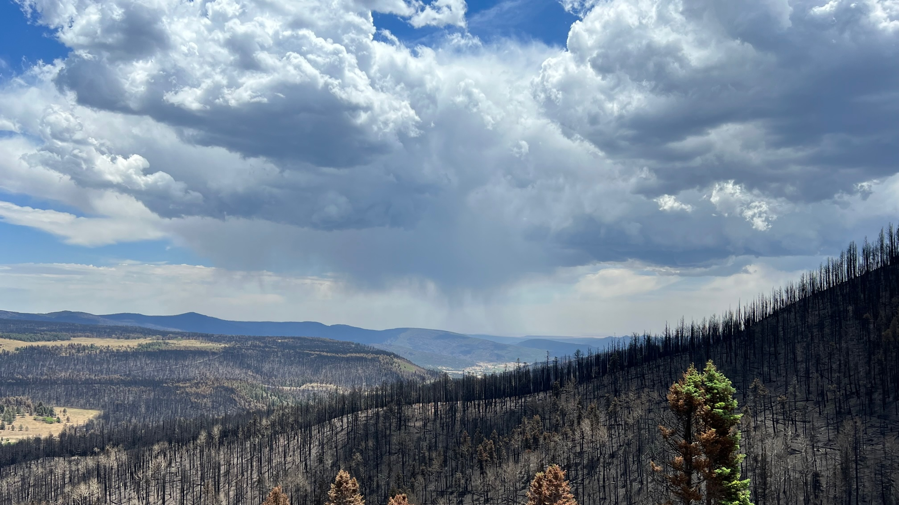
A Critical Moment in History
The urgent need for climate and health adaptation in New Mexico
Patrick Lohmann / Source New Mexico

Slide 2
“Anything else you’re interested in is not going to happen if you can’t breathe the air and drink the water. Don’t sit this one out. Do something. You are by accident of fate alive at an absolute critical moment in the history of our planet.” - Carl Sagan, 1994
Notes:
Madame Chair, Honorable members of the Committee...READ QUOTE

Slide 3
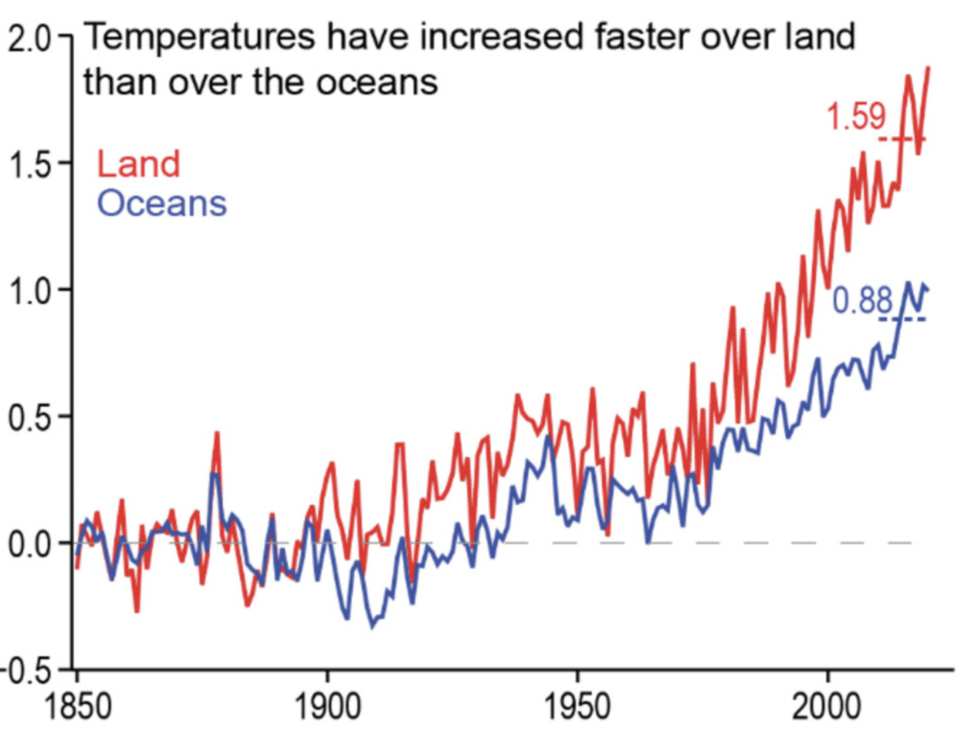
The world is warming
Emissions have raised global temperatures ~1.2 degrees. We are on course to reach 1.5 degrees, a critical threshold within a decade.¹
The rapid rate of change is stressing and collapsing many of the vital natural systems we rely on.
Like COVID, risks from climate change are not shared equally.
Notes:
Emissions have raised global temperatures ~1.2 degrees above the pre-industrial baseline. We are on course to reach 1.5 degrees, seen as a critical threshold by global experts, within the decade.¹
IPCC: Special Report: Global Warming of 1.5 ºC
WMO 2022, https://public.wmo.int/en/media/press-release/wmo-update-5050-chance-of-global-temperature-temporarily-reaching-15%C2%B0c-threshold

Slide 4
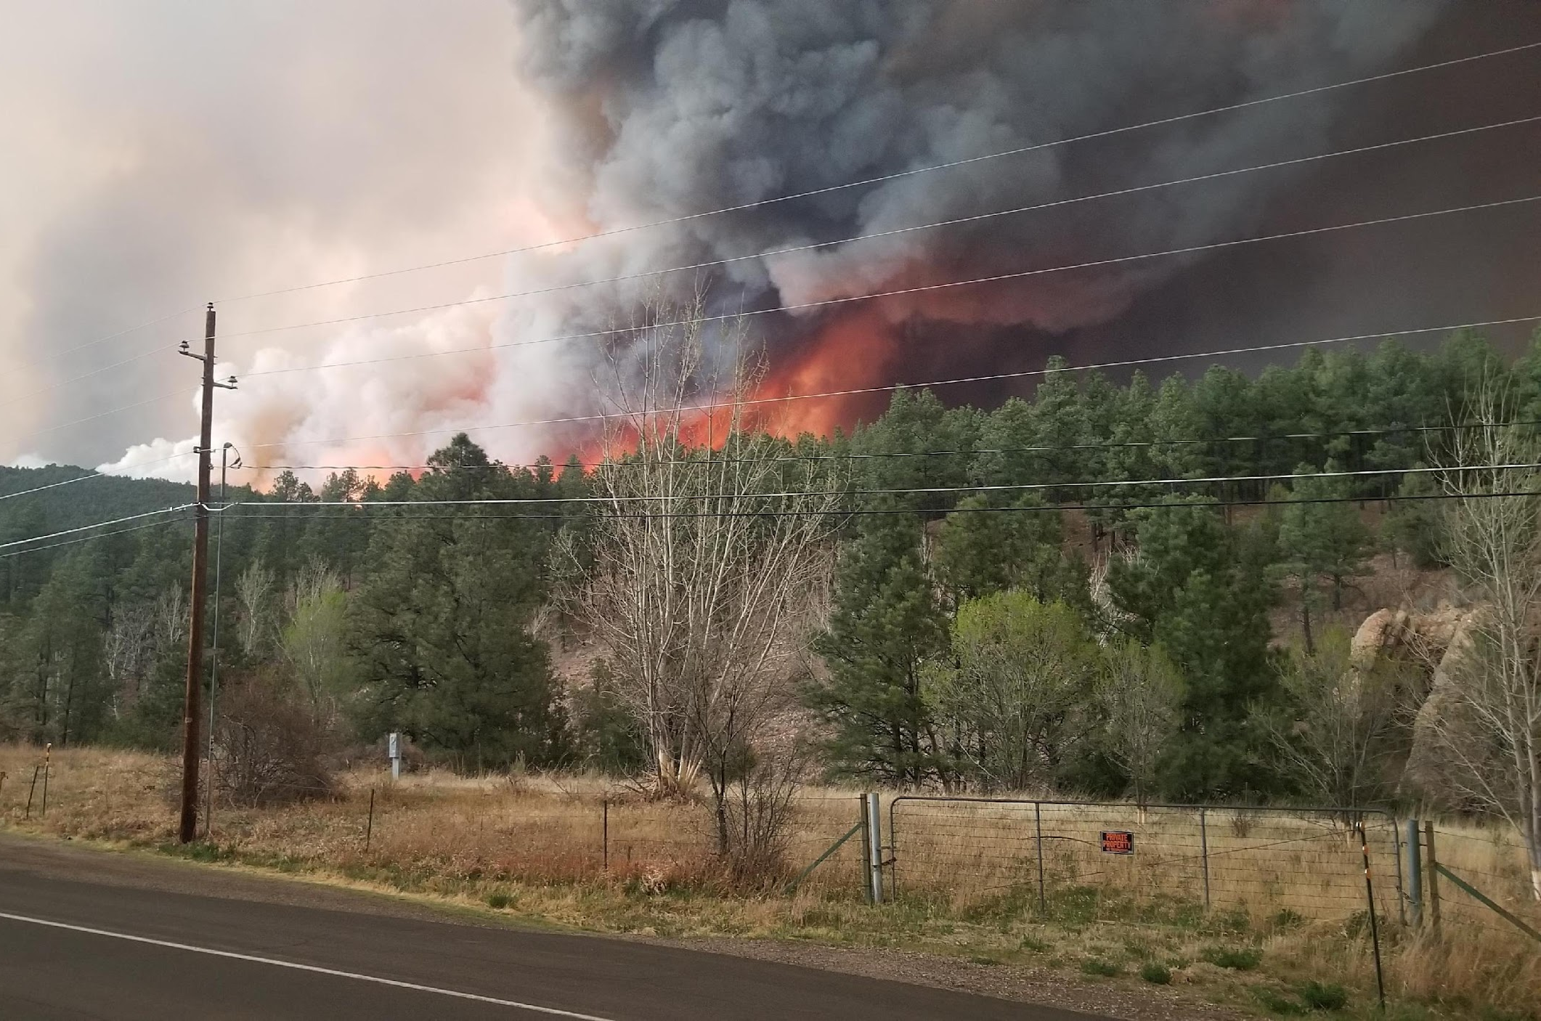
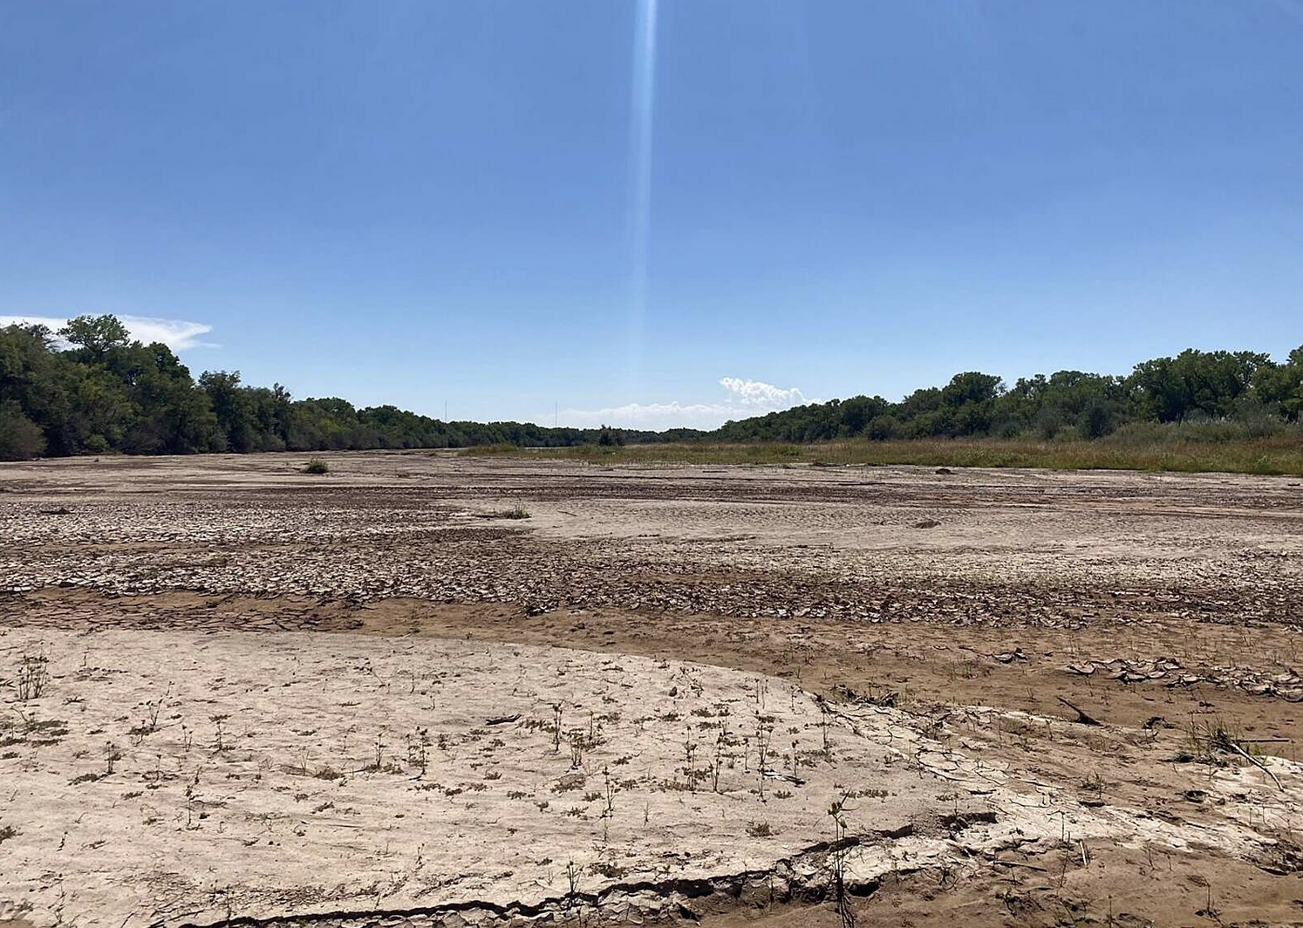
Already in New Mexico:
Historic drought
Historic wildfires
Historic temperatures
Historic storms
Historic vegetation loss
Will Harris
Marisa Demarco | Source NM
Notes:
“These are not one off records, this is not a mere coincidence, we will continue to see a pattern of worsening ecological impacts

Slide 5
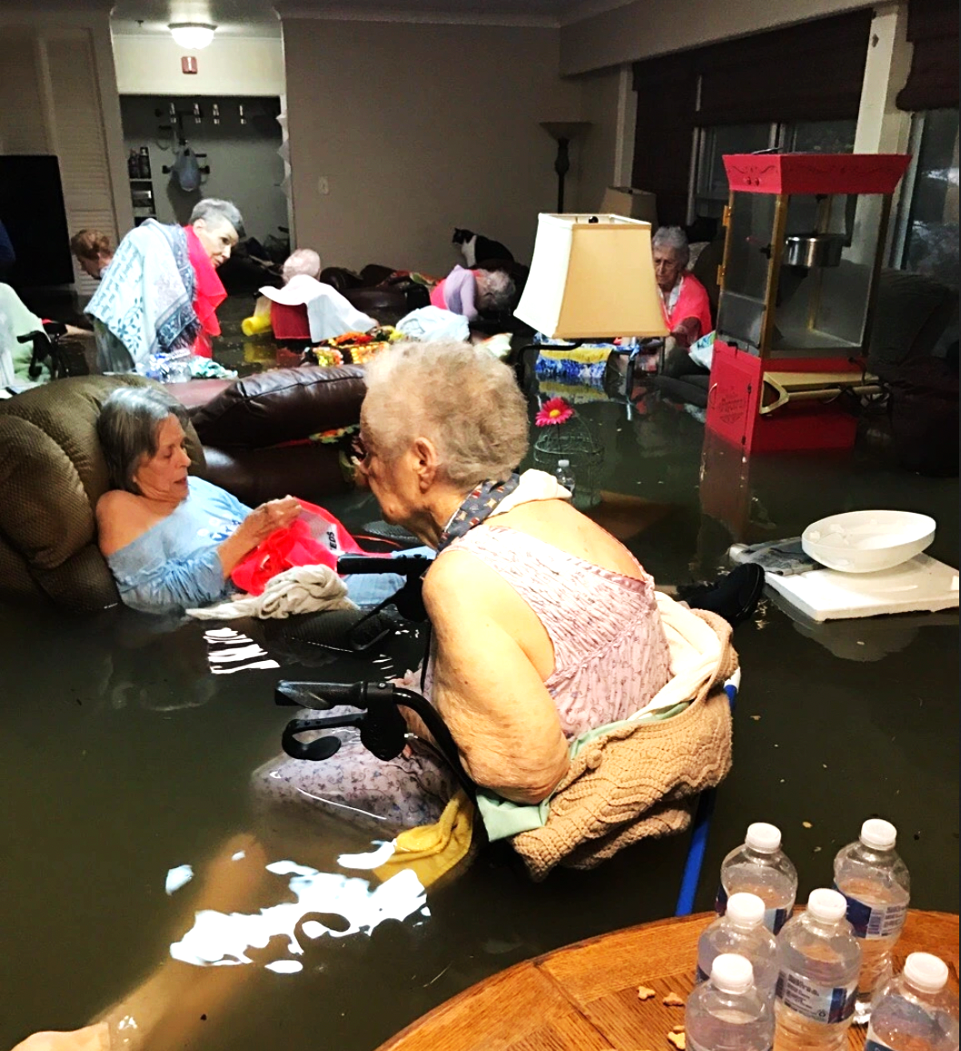
MOST VULNERABLE
[w/ percentage of NM population]:
Elderly – 18.5%¹
Children – 22.4% (5.4% under 5yo)²
People living in poverty – 18.2%⁶
Disabled – 26%³
Migrants – 10%⁴
Outdoor workers – 47%⁵
Homeless - 0.6%⁷
Mental Illness – 32%⁸
Substance Use Disorders
First Responders & healthcare workers
Notes:
1 – 2021 www.census.gov
2 - 2021 www.census.gov
3 – CDC Disability & Health U.S. State Profile Data: New Mexico
4 – American Immigration Council - https://www.americanimmigrationcouncil.org/sites/default/files/research/immigrants_in_new_mexico.pdf
5 – US Bureau of Labor statistics - https://www.bls.gov/opub/ted/2017/over-90-percent-of-protective-service-and-construction-and-extraction-jobs-require-work-outdoors.htm
6 - https://www.dws.state.nm.us/Portals/0/DM/LMI/Poverty_in_NM_2019.pdf
7- US Interagency on homelessness council - https://www.usich.gov/homelessness-statistics/nm/
8 - https://www.kff.org/statedata/mental-health-and-substance-use-state-fact-sheets/new-mexico/
Do NOT read all these – chose some …I’d select Disabled, Mental Health, Children and outdoor workers of all kinds.

Slide 6
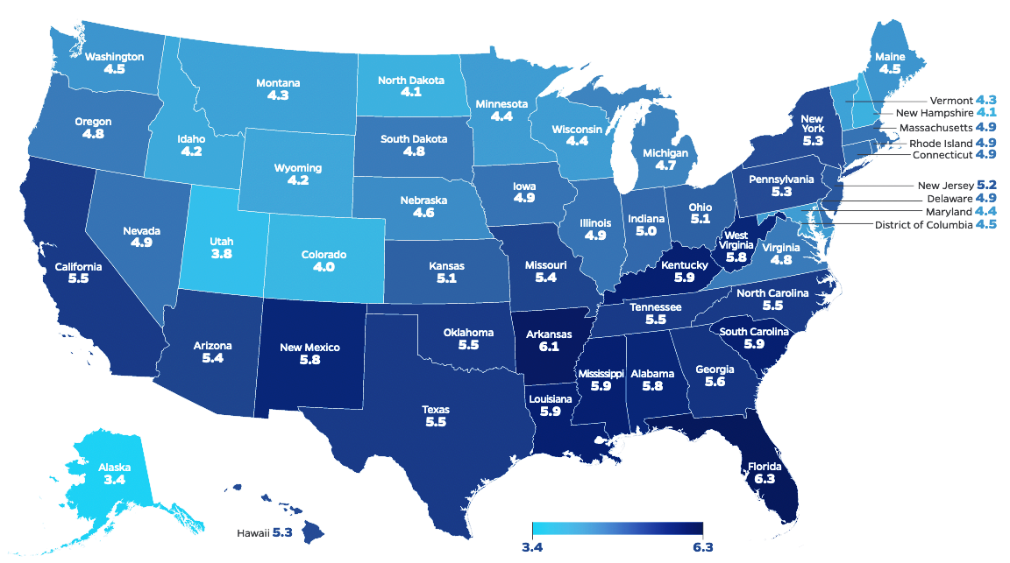
Notes:
Source: Climate Change & Health – Assessing State Preparedness, John Hopkins Bloomberg School of Public Health, and Trust for America’s Health, pg. 38

Slide 7
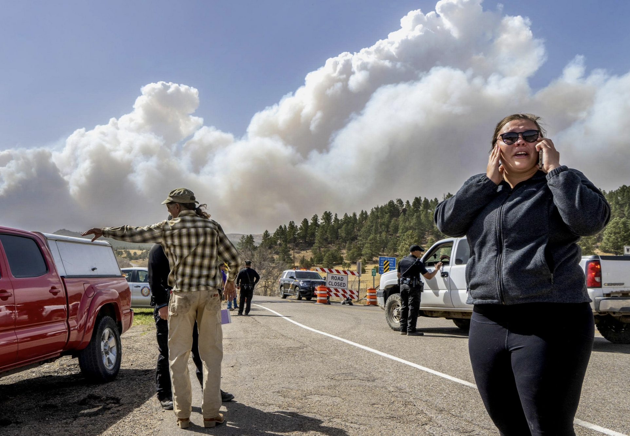
Vulnerability Feedback Loop
Loss of livelihood, loved ones, and community
Physical / Psychological Trauma
Loss of stability and support
A Cycle of Compounding Harms
Chronic diseases and diseases of despair
Difficulty accessing services
Eddie Moore/Albuquerque Journal
Notes:
What we are likely to see without sweeping public health interventions, is a cycle of compounding harms to those most vulnerable. For example, a wildfire can cause….READ SLIDE

Slide 8
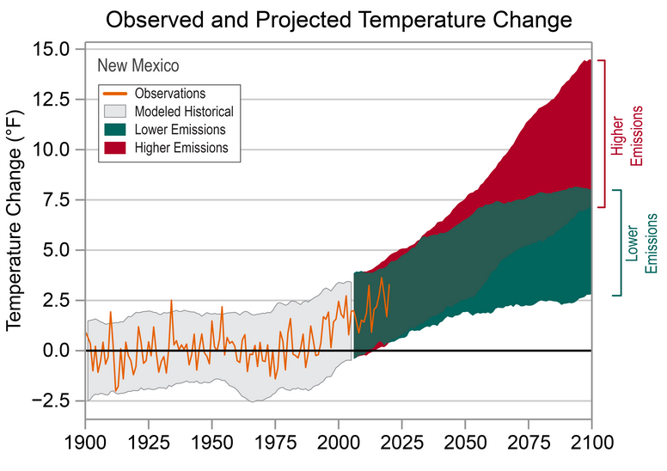
CISESS and NOAA NCEI
Notes:
This is what keeps me up at night. Even if we are to drastically reduce our greenhouse gas emissions today, represented by the green band, we will continue to see at least 50 years of additional warming. Doubling the temperature increase that we’ve already seen in New Mexico. This is the best case scenario.
Source: NOAA’s National Centers for Environmental Information (NCEI) and the Cooperative Institute for Satellite Earth System Studies (CISESS)

Slide 9
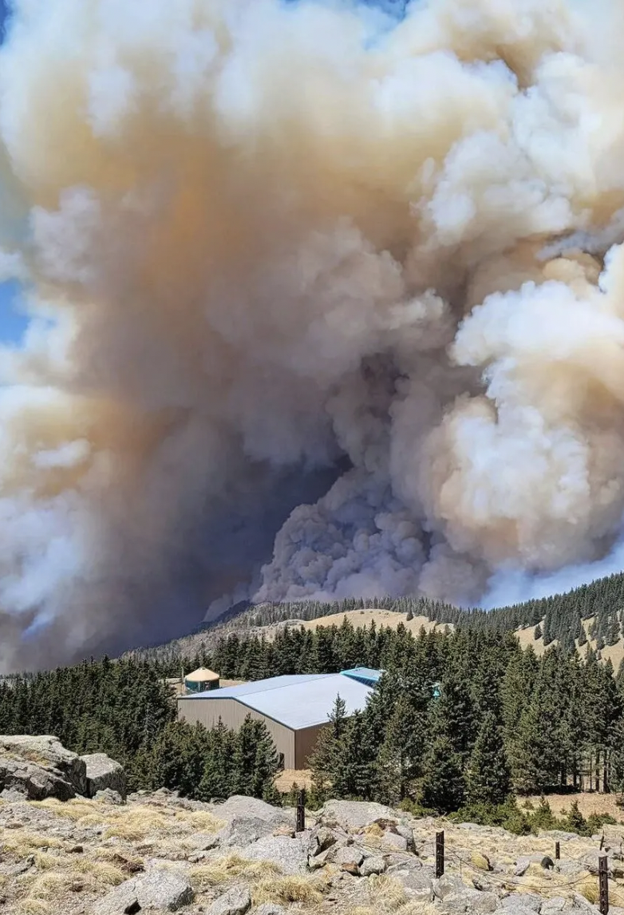
What we know
Temperatures will continue to rise 50+ years
The changes we’ve already seen will continue to get worse.
Climate-related hazards will grow in frequency, intensity, and duration.
The likelihood of disasters on an unprecedented scale will grow.
Likely to see direct and indirect impacts with significant social and economic implications
USDA Forest Service, via Associated Press

Slide 10
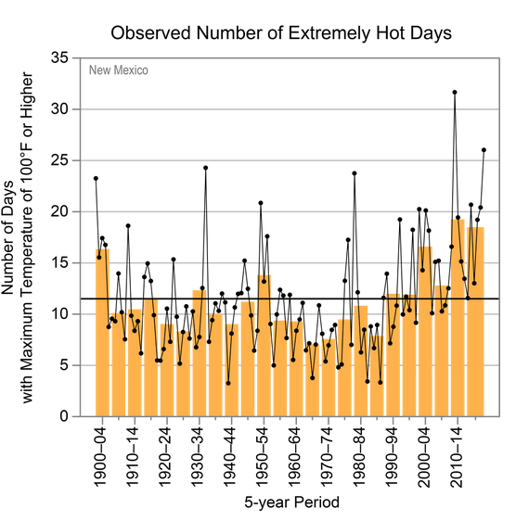
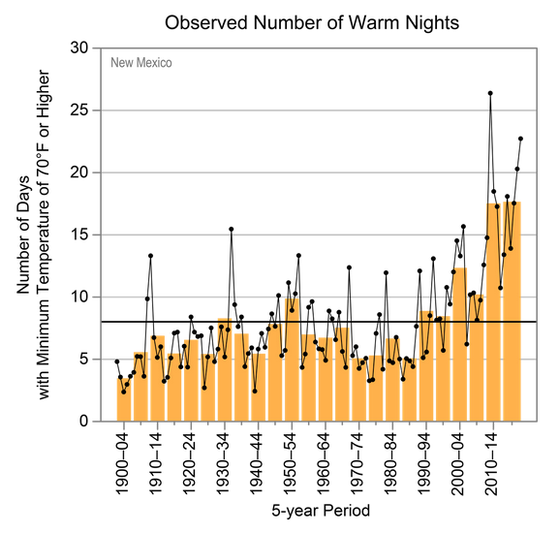
Days and nights are getting hotter:
Notes:
hot days and warm nights are increasingly common

Slide 11
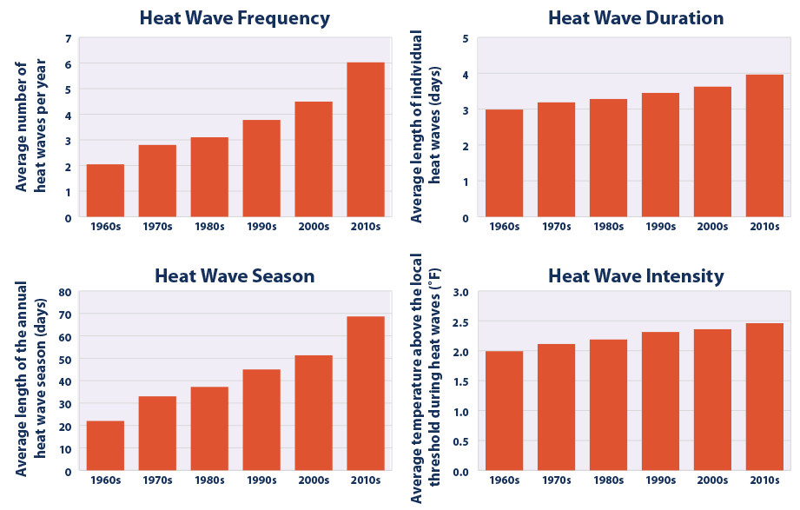
Notes:
Heat Wave Characteristics in the United States by Decade 1961-2019, NOAA, 2021. Heat stress dataset and documentation. Accessed February 2021. www.ncdc.noaa.gov/societal-impacts/heat-stress/data.

Slide 12
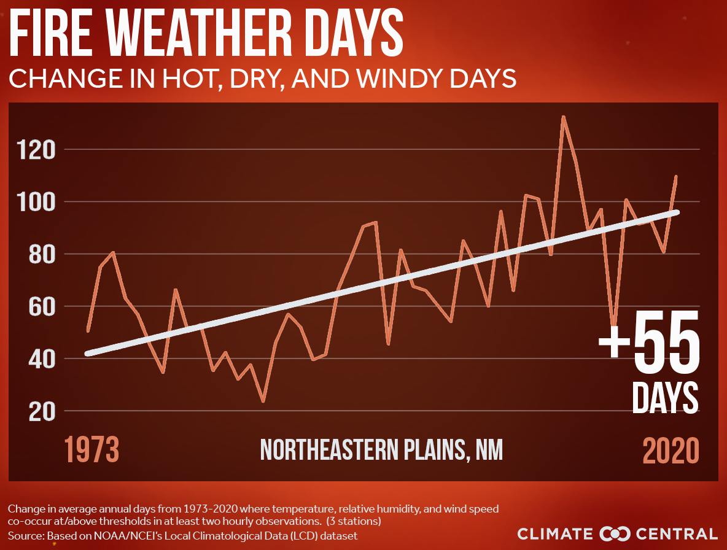
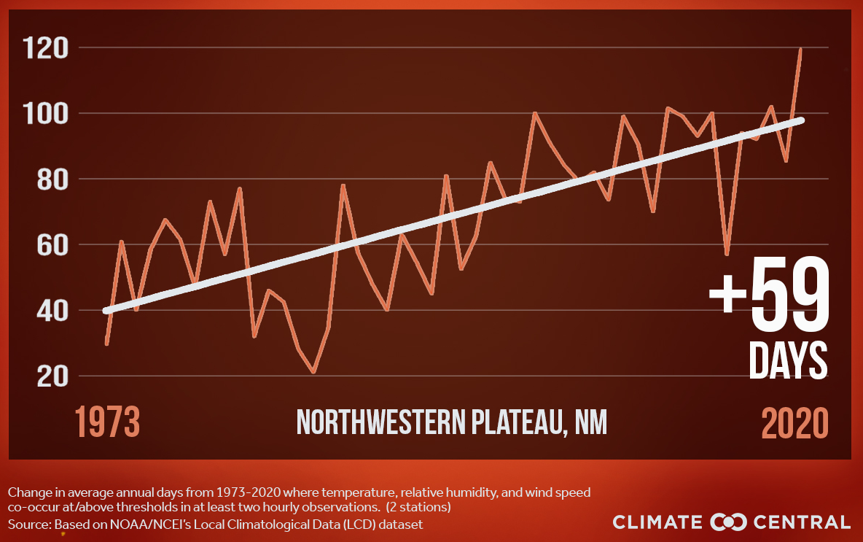
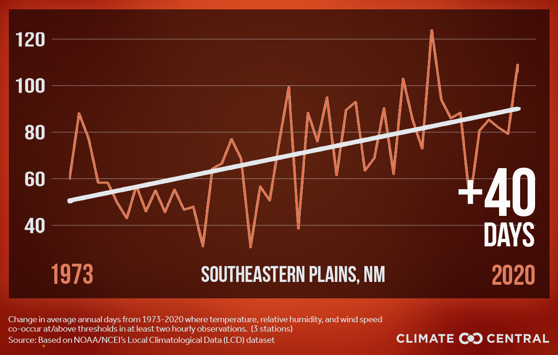
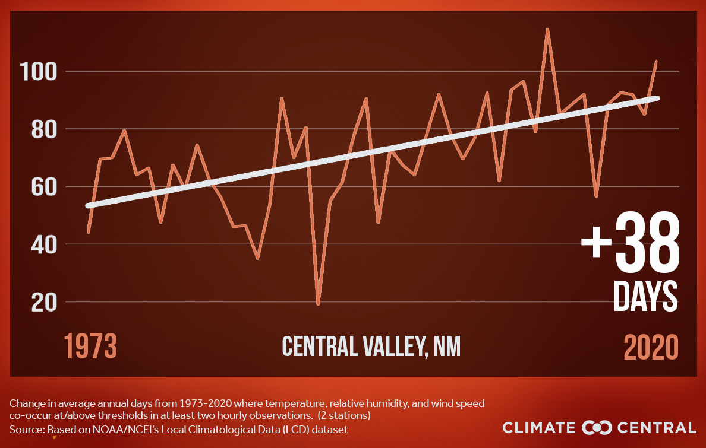
Dramatic increase in fire weather days:
Notes:
With some regions seeing an additional two months of days with extreme wildfire risk.

Slide 13
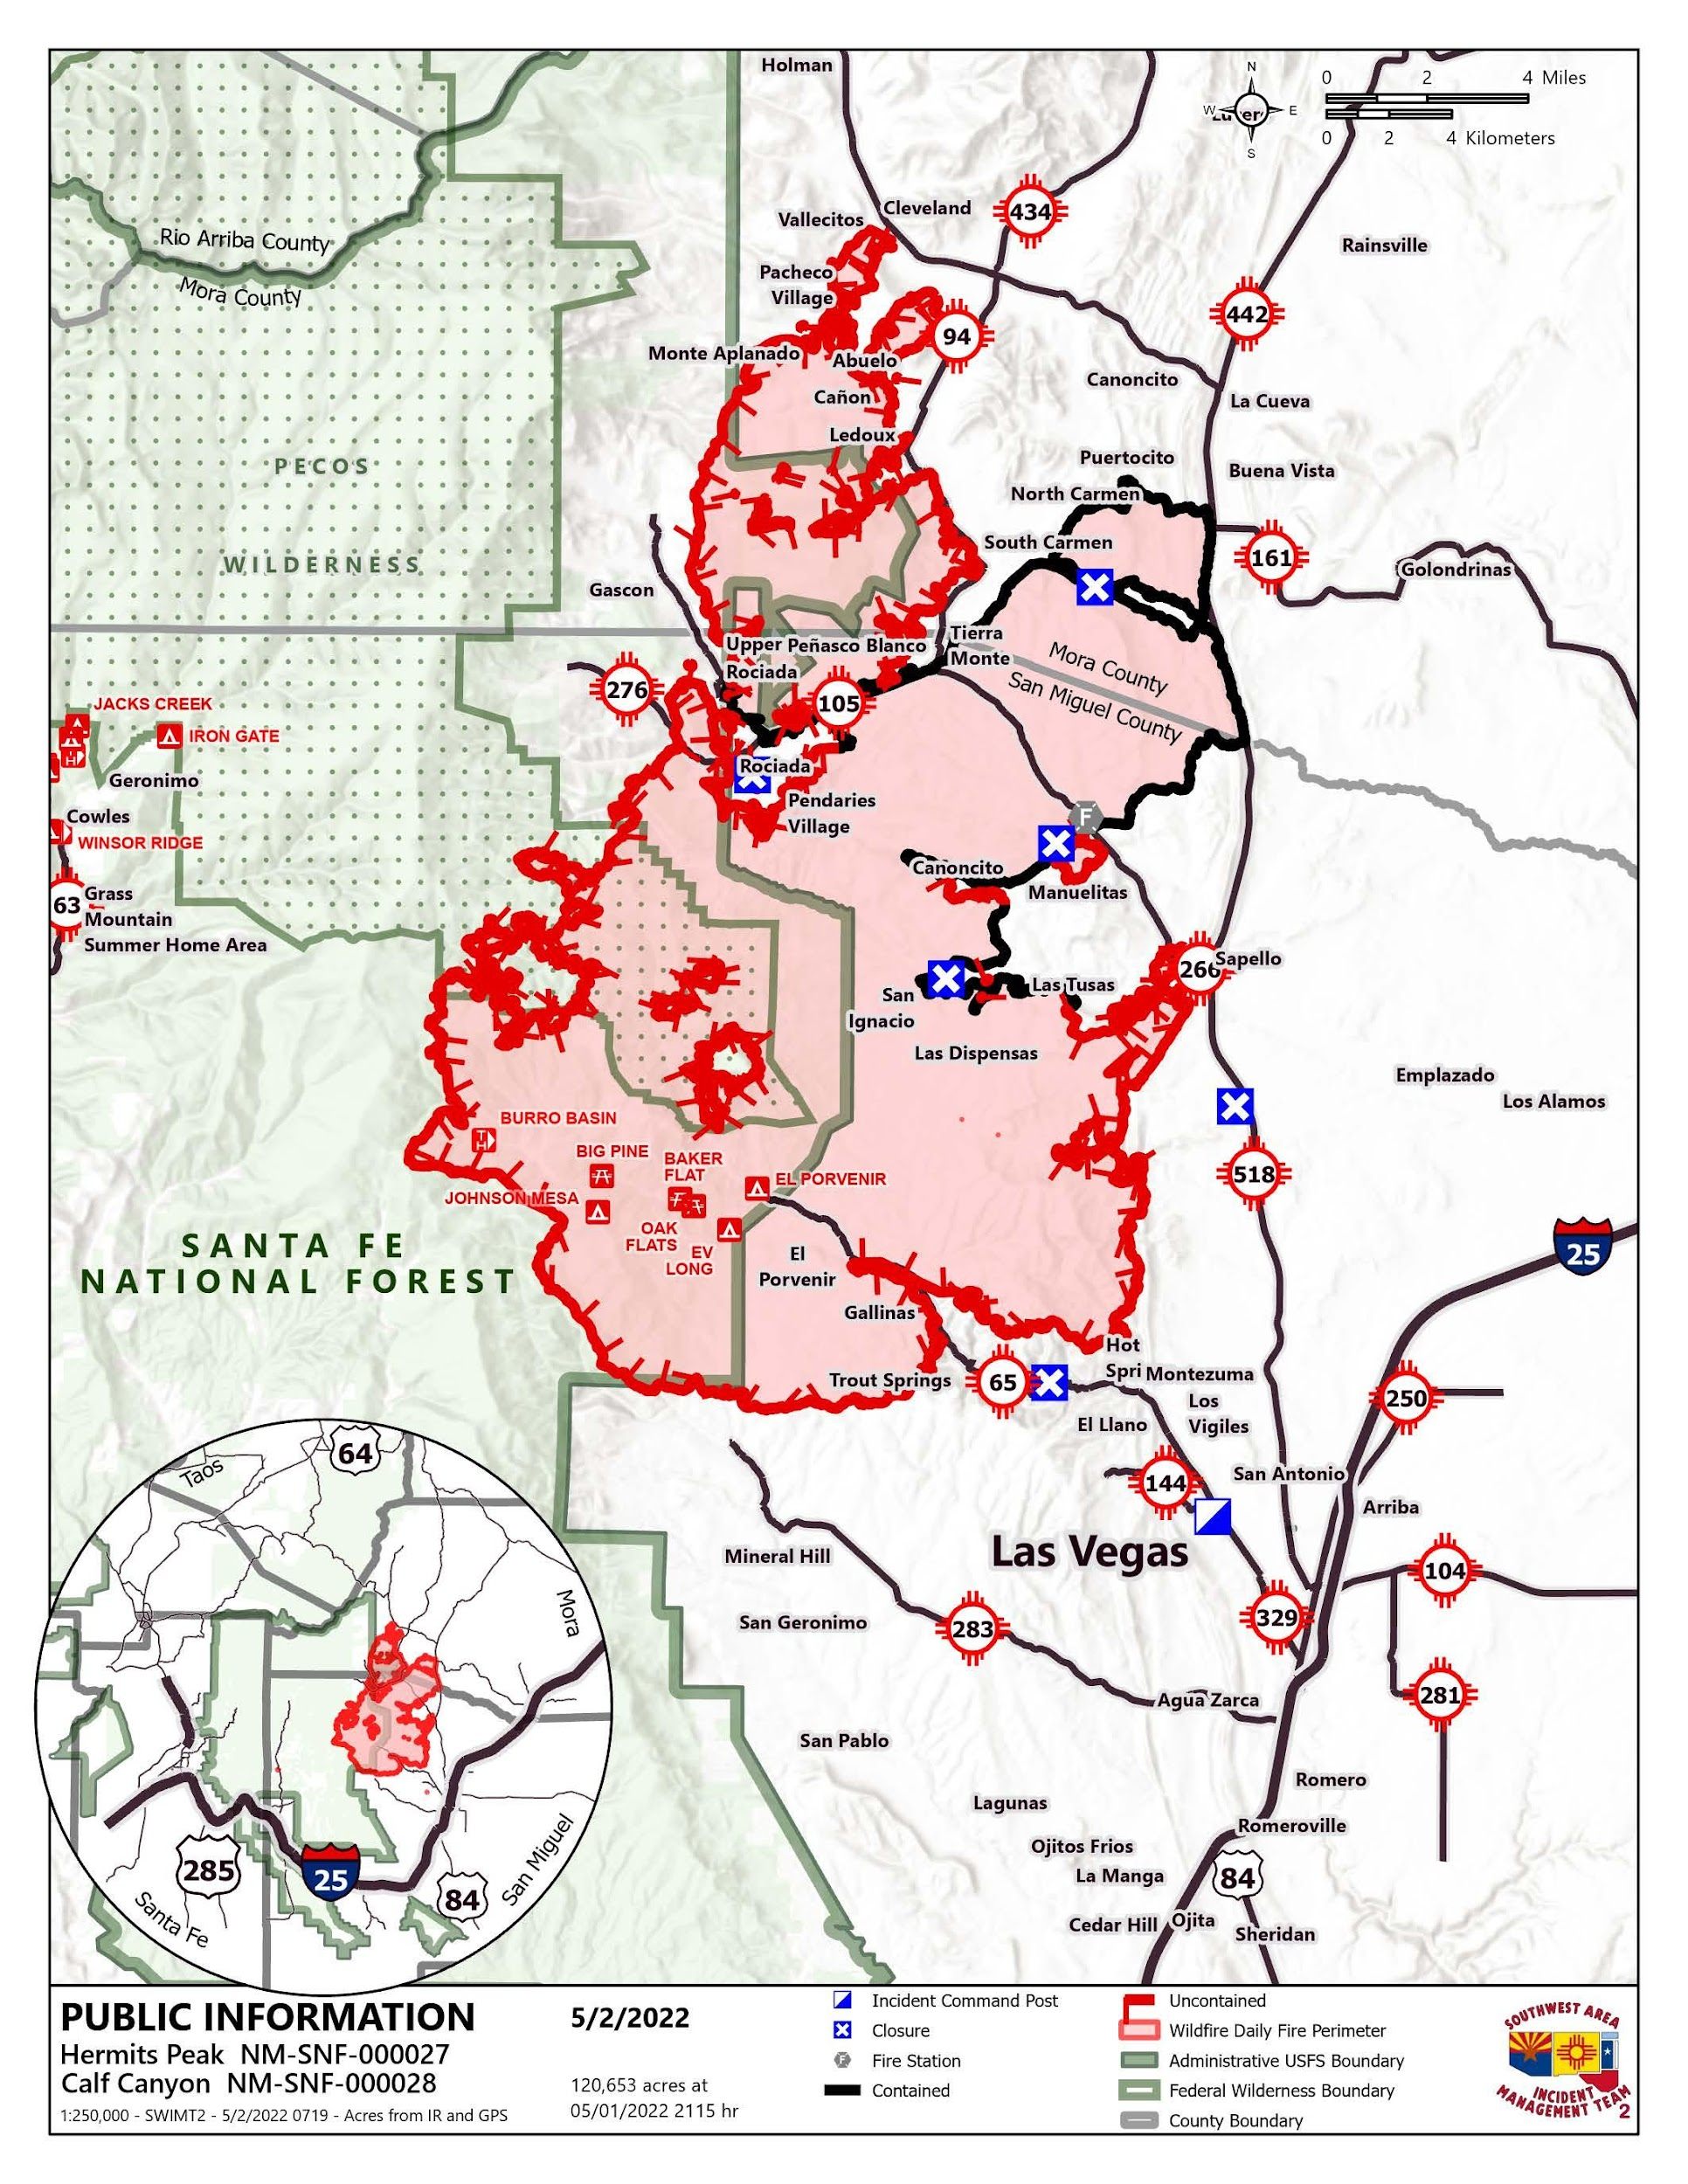
NM 2022 Wildfire Season
899,453 acres burned [over 1% of the entire areas of the state].
26,841 addresses were under evacuation in a single day [approximately 69,786 people].
Approximately 1,450 homes were destroyed, impacting 3,800 people.
Notes:
69,786 people is equivalent to 3% of the total state population or two thirds of the entire city of Las Cruces told to flee their homes.
Skim over this quickly – “everyone in our state knows just how devastating the direct impact o the 2022 fire season has been in NM. This will repeat – there will be more such fires in our near future”

Slide 14
Hot-Dry Feedback Loop
DRY
Hydrophobic soil
Increases evaporation
Stress and loss of vegetation
Hotter Temperatures
Less snowpack
More evaporation
Stress and loss of vegetation
Vegetation Loss:
Reduces soil moisture
Increases ambient temperatures
Increases wildfires
hydrophobic soil
Notes:
As the state heats up, becomes drier, and we lose more vegetation, we will find ourselves in an amplifying feedback loop. In a recent report by the New Mexico Bureau of Geology and Mineral Resources they found that over the next fifty years we will see “increasingly arid conditions, including decreased soil moisture, stressed vegetation, and more severe droughts. Snowpack and associated runoff will decline substantially…and warmer temperatures will cause lower river flows due to increased evaporation”
Source: Climate Change In New Mexico Over the Next 50 years - https://geoinfo.nmt.edu/ClimatePanel/report/WaterClimateReport_Web_FINAL.pdf

Slide 15
DOWNSTREAM
POVERTY & FOOD INSECURITY
DISEASES OF
DESPAIR
DETERIORATING HEALTH &
WELLBEING
LOSS OF SUPPORT
Notes:
All of these changes to our natural environment mean significant impacts to human health and the worsening of already existing social and economic inequities.

Slide 16
Heat impacts on NM communities
Increase in heat-related hospitalizations
Between 2009 and 2020, emergency room visits in NM for heat stress doubled. This largely undercounts the true impacts, as heat stress can manifest in respiratory and cardiovascular emergencies.
Heat waves already kill more people in the US each year than any other weather-related hazard

Slide 17
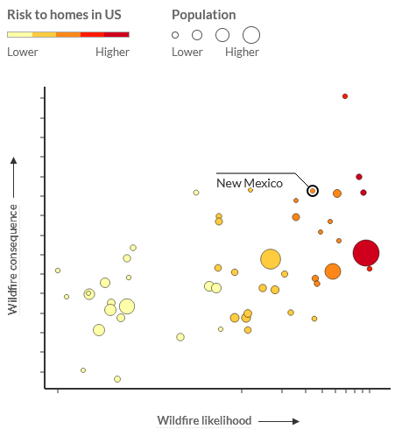
Wildfire impacts on NM communities
Increase in wildfire-associated hospitalizations and deaths
Morbidity and mortality from burns
Smoke inhalation
Indirect trauma associated with evacuations
Post-wildfire flooding
Damage to critical infrastructure
Water contamination
Notes:
Health Impacts of Wildfires, Finaly 2012 0 https://www.ncbi.nlm.nih.gov/pmc/articles/PMC3492003/
USDA & US Forest Service Wildfire Risk: https://wildfirerisk.org/explore/0/35/

Slide 18
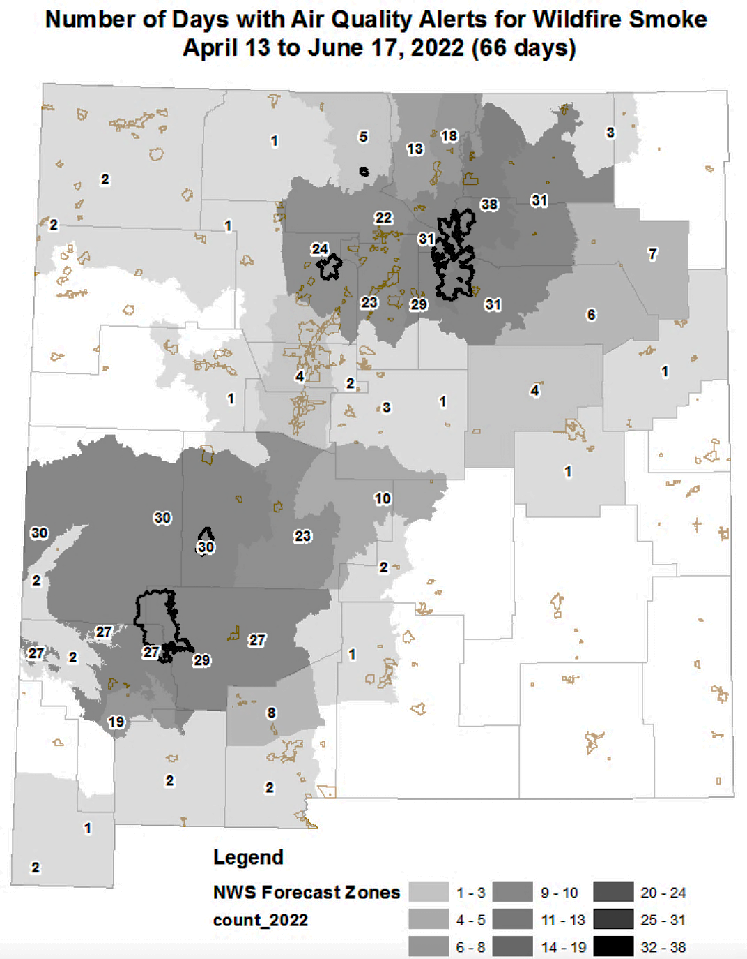
Smoke impacts on NM communities
Increase in smoke-related hospitalizations and deaths.
This summer alone, we saw 2,555 respiratory ED visits in NM, an 18% increase compared to previous summers. 80% of the patients being from the most vulnerable communities (SVI).¹
Long-term exposure to smoke has been linked to:
Development of childhood asthma
Increase in risk of heart palpitations and heart attacks
Decreasing lung function
Notes:
1: NMDOH

Slide 19
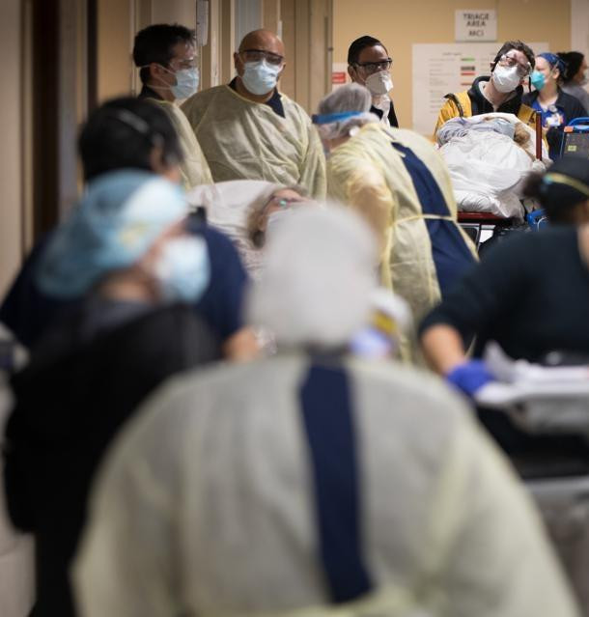
Impacts to Healthcare
Decreasing access
Decreasing quality¹
Increasing need
Notes:
As climate change impacts our health, so too does it impact our healthcare systems. Increasing need can overwhelm healthcare facilities, facilities which may be impacted by infrastructure damage or difficulty getting staff into the facility. This surge in demand, as we saw during COVID, can decrease access, especially to those with chronic diseases. As people’s diseases or injuries go untreated or unmanaged, this only further increases need for healthcare services, particularly acute care.
1. Kadri SS, Sun J, Lawandi A, et al. Association Between Caseload Surge and COVID-19 Survival in 558 U.S. Hospitals, March to August 2020. Ann Intern Med. 2021

Slide 20
Critical Infrastructure
Large-scale displacement
Supply chain disruptions
Infectious disease risks
Injury and suffering
Notes:
Additional ways that climate change can negatively impacts human health are numerous. I tried to summarize the most prominent via these New Mexico-specific media headlines

Slide 21
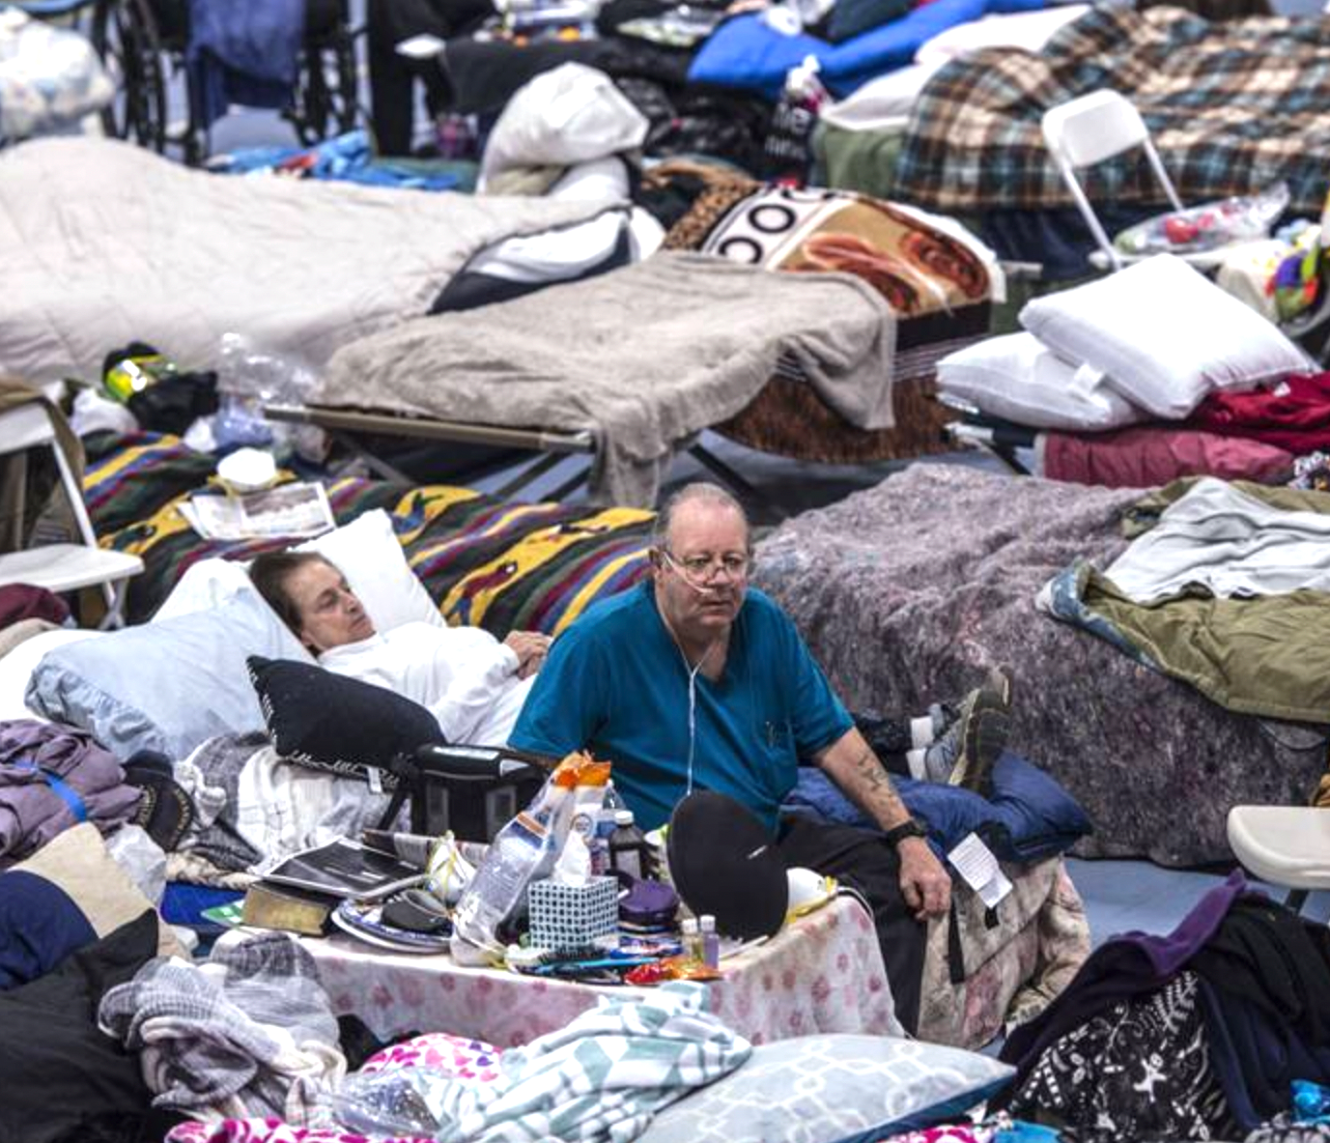
Downstream & Long-term Impacts
Mental health stressors, psychological trauma, and adverse childhood events ¹
Increase in poverty and food insecurity²
“Diseases of despair”- suicidality, substance use disorder³
Chronic diseases⁴
Political tensions over scarce resources⁵
Hector Amezcua
Notes:
The downstream and long-term impacts on human health are critical to understand. With growing exposure to climate hazards, we are more likely to see
IPCC Climate change 2022: impacts, adaptation, and Vulnerability
IPCC Special Report: Special Report on Climate Change and Land
CDC, https://www.cdc.gov/climateandhealth/effects/mental_health_disorders.htm & American Psychiatric Association: https://www.psychiatry.org/patients-families/climate-change-and-mental-health-connections/affects-on-mental-health
Prevalence Rate of Diabetes and Hypertension in Disaster-Exposed Populations: A Systematic Review and Meta-Analysis - https://www.ncbi.nlm.nih.gov/pmc/articles/PMC7445951/
IPCC - Climate Change 2014: Impacts, Adaptation, and Vulnerability. Part A: Global and Sectoral Aspects

Slide 22
Costs will skyrocket: a ‘spiral of self destruction’
Notes:
Cost associated with these direct and indirect impacts will go up, not just for state and local governments, but also to communities, and especially to vulnerable individuals.
According to the UN, we can expect, statistically speaking, 1-2 disasters, causing over a billion dollars in damage, every single day by the year 2030.

Slide 23
Unprecedented events are becoming common
“Looking into the future, in a world with 2°C of global warming (0.8°C warmer than today which at current emission levels would be reached as early as the 2040s )…an event like this – currently estimated to occur only once every 1000 years, would occur roughly every 5 to 10 years.”
Philip et al., 2021
World Weather Attribution
Notes:
Unprecedented disasters, such as the 2021 PNW heat wave are becoming common place. This once-in-a thousand year heatwave, according to experts at the World Weather Attribution Initiative, would be virtually impossible under pre-climate change conditions. However, projections show that these events will become a once every 5-10 year heatwave as early as the year 2040

Slide 24
Schramm et al. 2021 - CDCMMWR
“We had calls for help coming in every 30 seconds”
- Snohomish County EMS
Notes:
As someone who worked on the emergency response to the 2021 heat wave, we were all caught off guard. Even as someone who studies these hazards, the sheer magnitude was unbelieveable. Temperatures were 30 degrees above normal. Healthcare and emergency response services were on the verge of collapse due to incredibly high demand. The community at large didn’t know how to stay cool, didn’t have the tools to lower indoor temperatures, and we were very lucky that the electric grid remained functioning under a huge spike in energy demand. The top left graph shows the dramatic spike in ED visits. The right graph shows the tragic consequences. Close to 500 people lost their lives. Making this the most deadly weather related disaster in WA state history.

Slide 25
Notes:
As awareness to the public health impacts of climate change grows, we see a growing sense of urgency and calls for sweeping action to address climate change as a public health emergency.

Slide 26
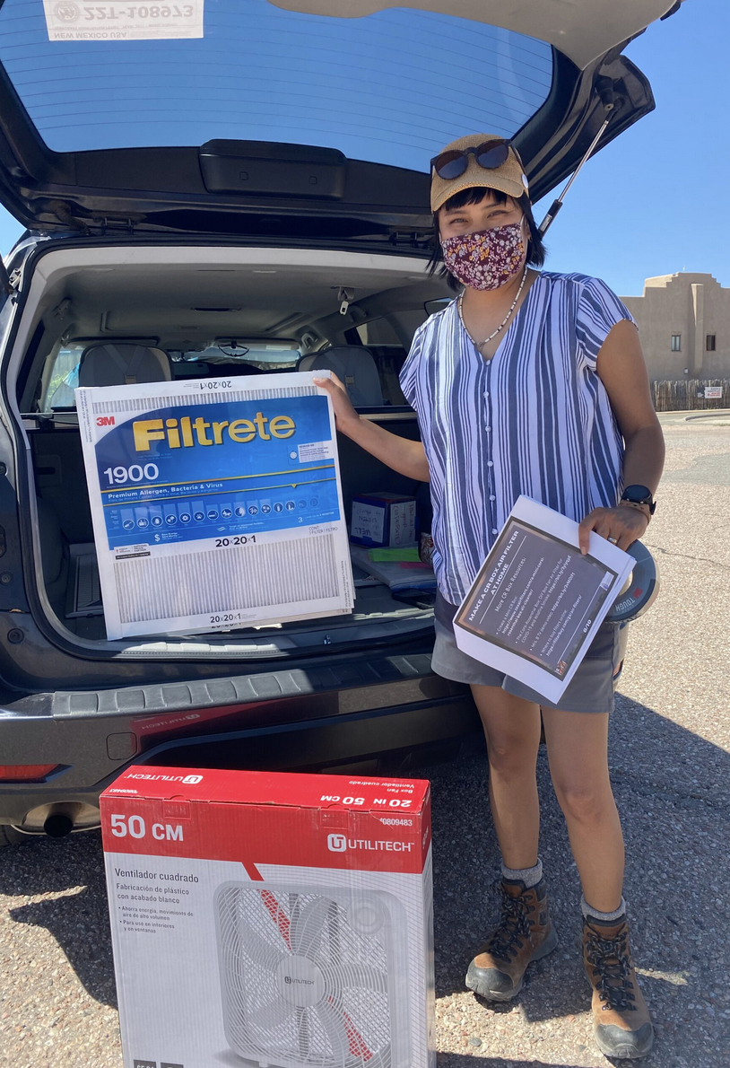
Adapting is an opportunity to improve the health of all New Mexicans
Address underlying inequities
Foster connected and empowered communities
Reduce outdoor and indoor air pollution
Preparing communities for extreme weather
Develop more resilient infrastructure
Promote co-benefits of mitigation and adaptation (e.g. insulation & micro-grids)
Education and outreach about the health impacts of climate change and collective actions.
Image: Photo courtesy of the Coalition to Stop Violence Against Native Women, SourceNM, 2022
Notes:
In addition to simply reducing our emissions, adapting to the unavoidable changes which we have already experienced and will continue to experience over the next 50 or more years, is critical to protect and improve the health of all New Mexicans.
Read through each

Slide 27
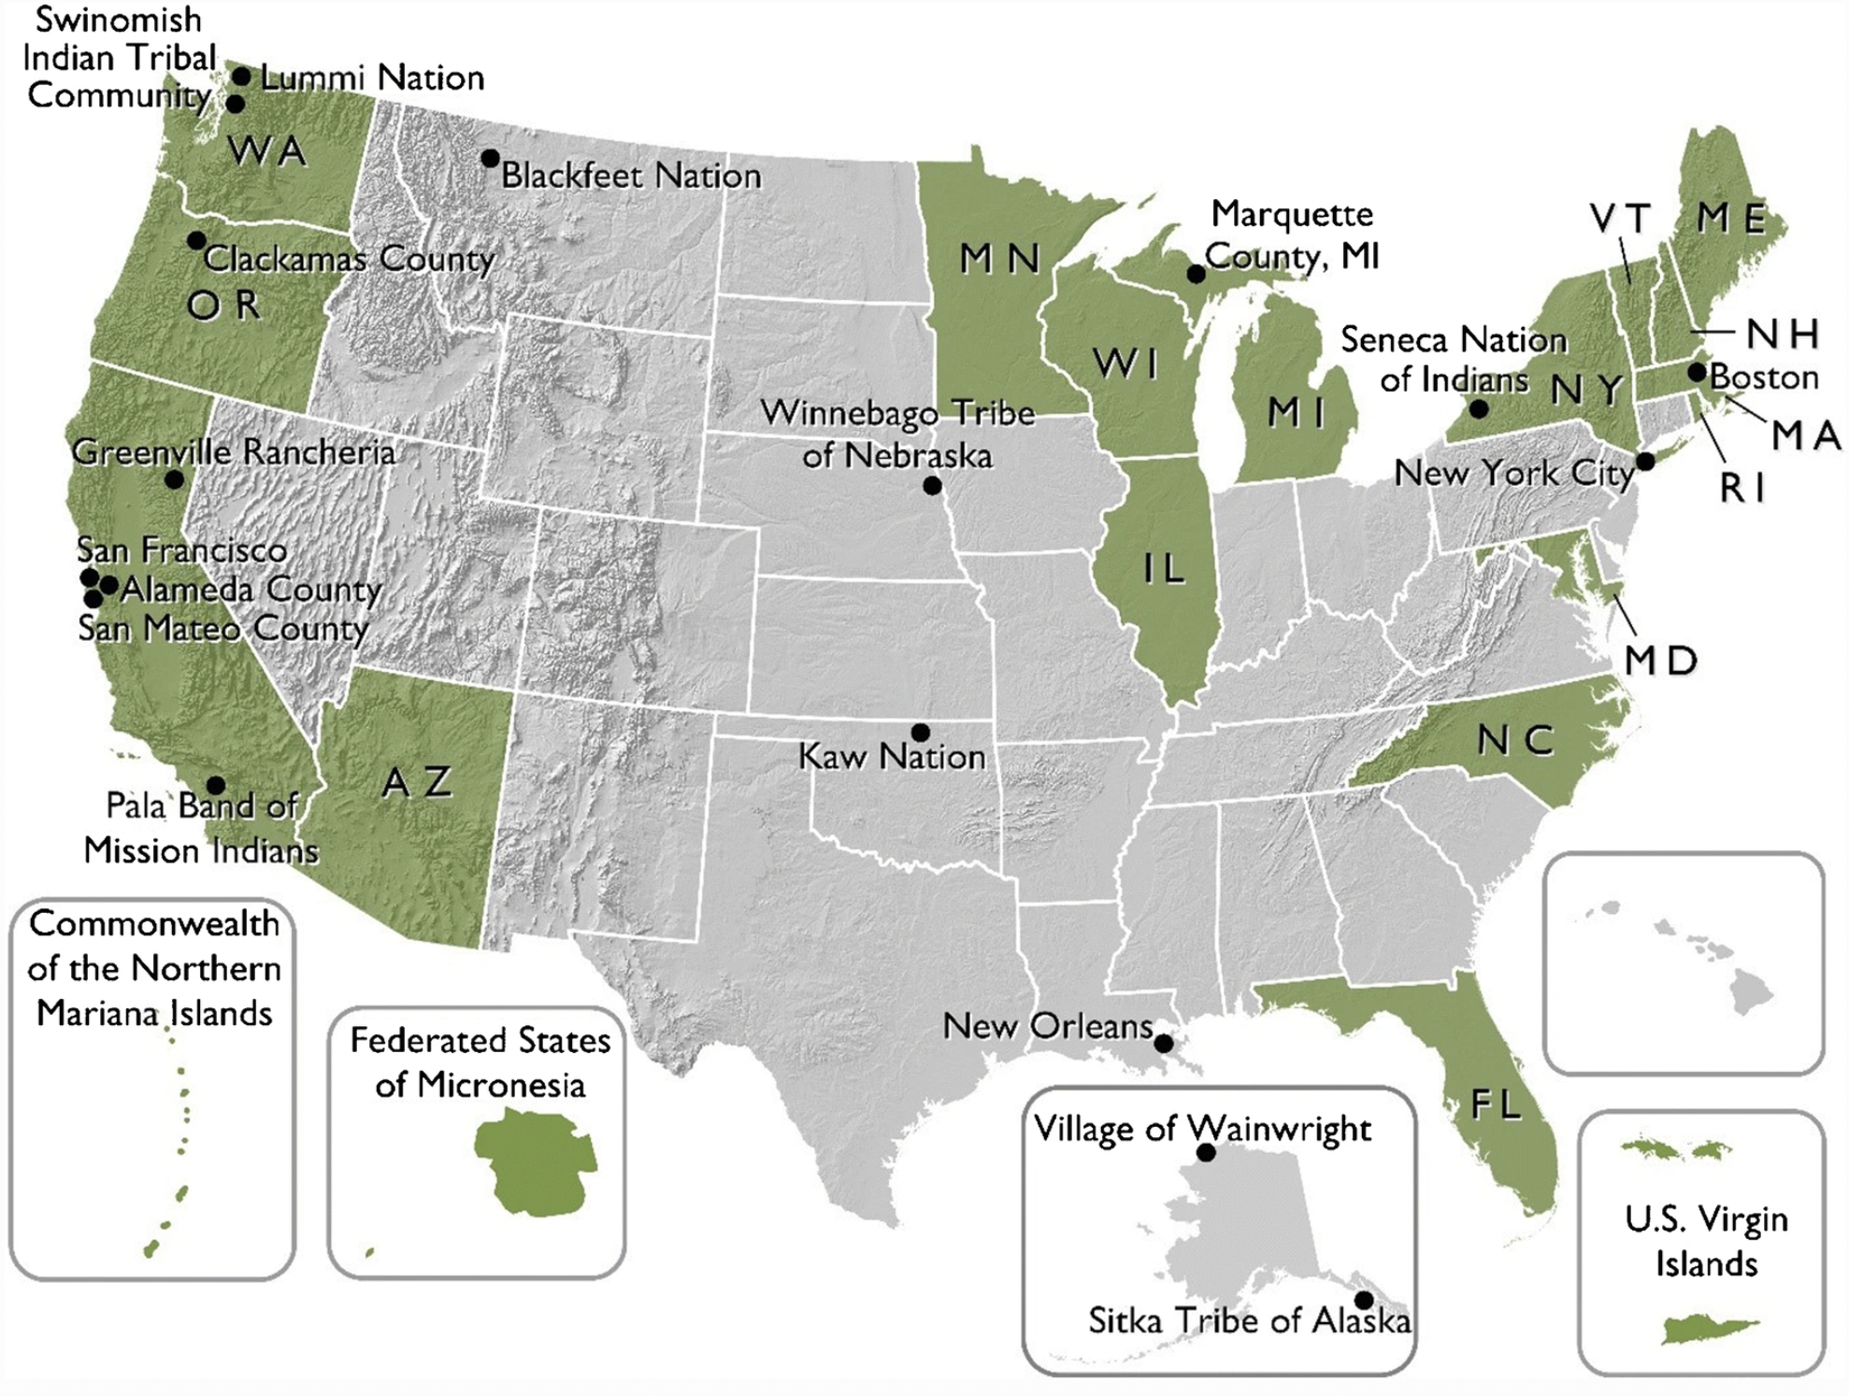
Climate and health programs across the U.S.
Building Resilient Infrastructure and Communities (BRIC)- FY 2020
[excludes state allocations, management costs, and tribal set-aside]
Notes:
On the left we see which states have climate and health programs, with significant overlaps with states which had local jurisdictions apply for BRIC grants in 2020, seen on the right.
We can also see that no local jurisdictions in NM applied or received funding for climate adaptation that year. Local governments can’t apply directly, so states are ultimately responsible for ensuring interested communities are aware of funding and technical assistance opportunities, supporting them in applying, and making sure that projects are eligible.” That’s why a critical part of a climate and health program is working across departments and directly with communities, to ensure that they have the resources and support they need to apply for this funding.
BRIC analysis: https://www.nrdc.org/experts/anna-weber/building-resilience-bric-bric

